Slide 1



CRIME DATA ANALYSIS
PROJECT #1 – 02/04/2021
Team Members:
Maria Barrera
Brian Figg
Jake Perry – Git Master
David Zapata
Support: Anthony Taylor
Mark Flynn
Zach Grinacoff

Slide 2
Project Hypothesis / Core Message
Hypothesis: Crimes are tied to institutions of similar nature
Crimes may also be associated with population.
Goal: Identify trends in the data to determine Correlation / Causation relationship.

Slide 3
Interesting Questions / Motivations
Do places with casinos attract more criminal activities related to gambling crimes? ie. robbery, racketeering
Do gun stores increase gun crime activities?
Also: Population & reported gun crimes
Is there a relationship between the number of liquor stores to the number of reported crimes?

Slide 4
Summary of Data Sources
OpenJustice website
Census Data
Google Maps
CA Dept of Alcoholic Beverage Control
City of Los Angeles
NYPD

Slide 5
Data Analysis
For Gun Crime vs. Gun Stores, since NYC and LA have similar numbers of gun stores and similar Population size, comparing crime rate is key to the analysis.

Slide 6
Does Gambling Attract Crime?
Scholarly research has been done to answer whether Casinos attract crime. A Great starting point to search for answers.
Casinos, Crime, and Community Costs
by Earl L. Grinols and David B. Mustard ; The Review of Economics and Statistics
Vol. 88, No. 1 (Feb., 2006), pp. 28-45 (18 pages)
Published By: The MIT Press
Casinos and crime in the USA
Douglas M. Walker, College of Charleston; https://www.researchgate.net/publication

Slide 7
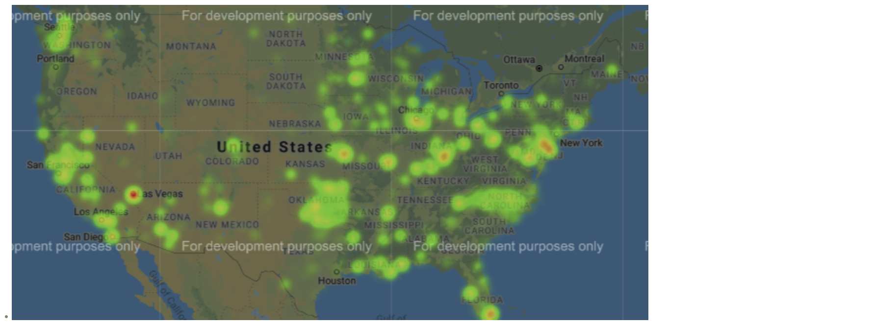
Heat Map of Casinos Across the United States
The Heat map shows the instance of recorded crimes across the continental United States.

Slide 8
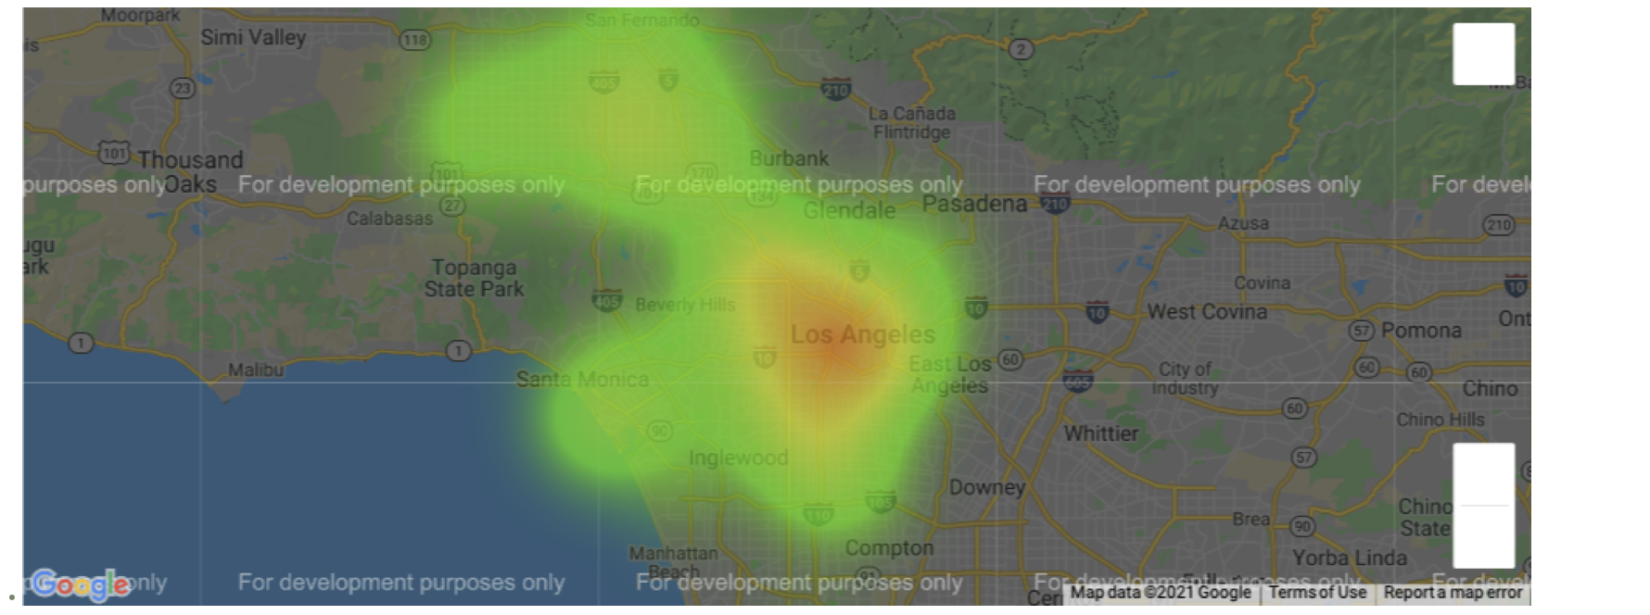
Heat Map of Los Angeles

Slide 9
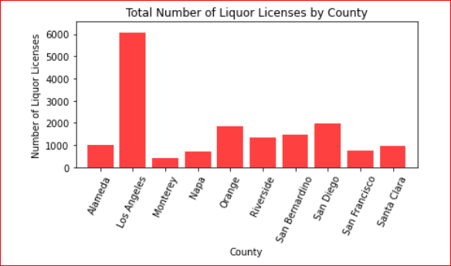
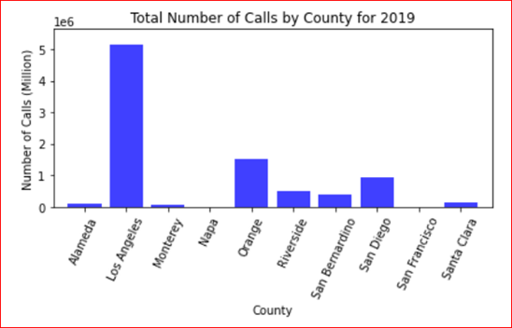
Number of Liquor Licenses vs Number of Calls

Slide 10
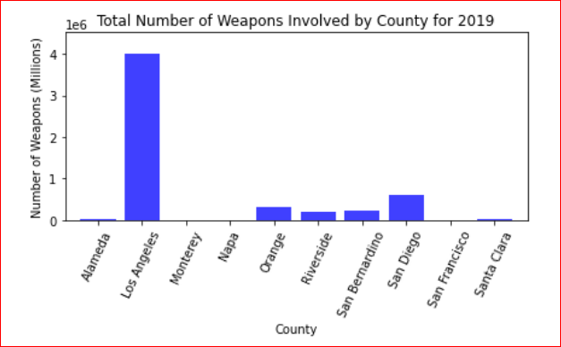
Number of Liquor Licenses vs Number of Weapons

Slide 11
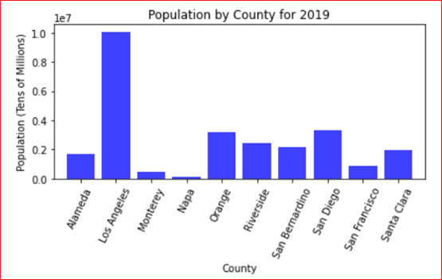
Number of Liquor Licenses vs Population

Slide 12
Population vs Number of Calls

Slide 13
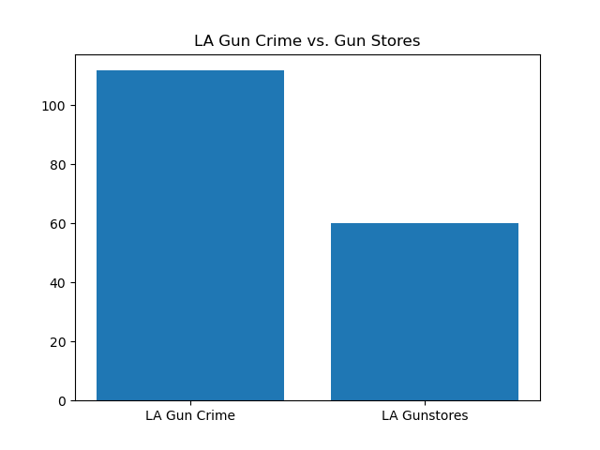

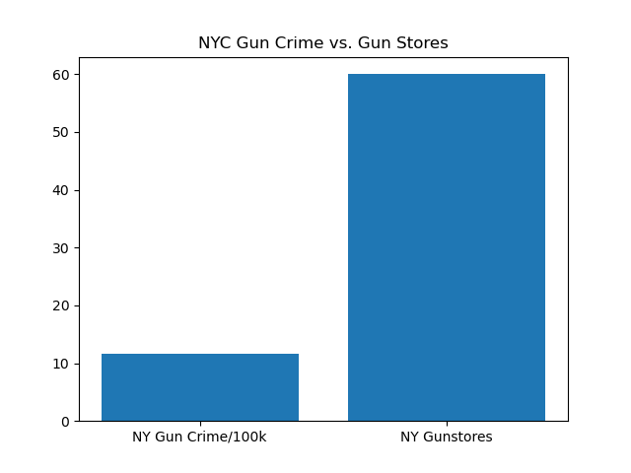

Crime vs Gun Stores

Slide 14
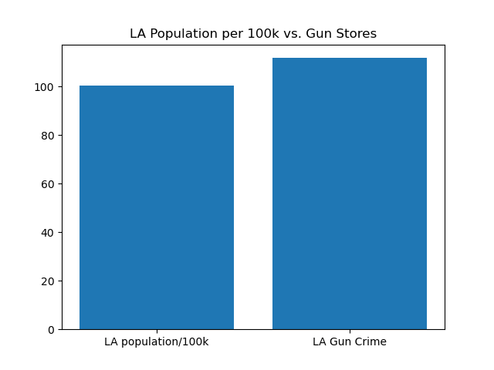
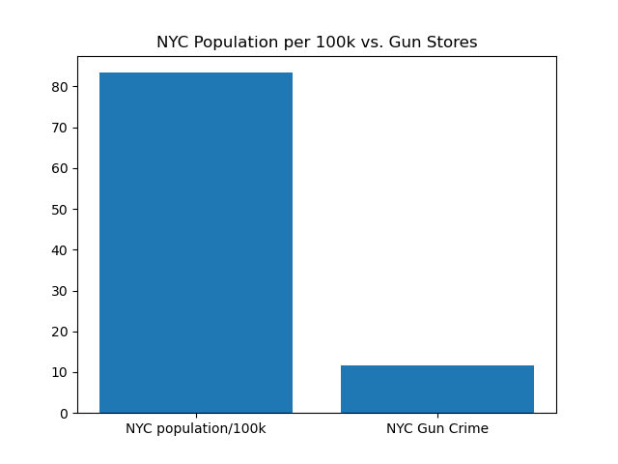
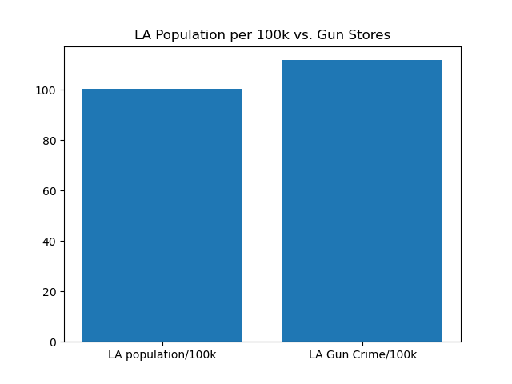

Population per 100k vs Gun Stores

Slide 15
Conclusions and Connections thus far
Casinos have no impact on crime
Liquor stores have some impact on Domestic Violence
Gun Stores have no impact on Gun Crime
Population has no Causation with Gun Crime

Slide 16
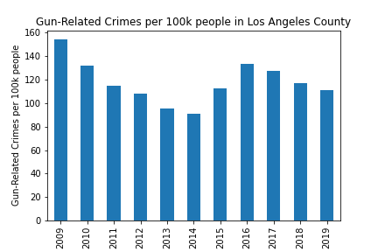
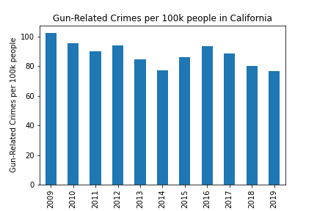
Gun Crime and Population
LA County Population
Between 9.8 Million & 10.1 Million
CA Population
Between 36.3 Million & 39.3 Million

Slide 17
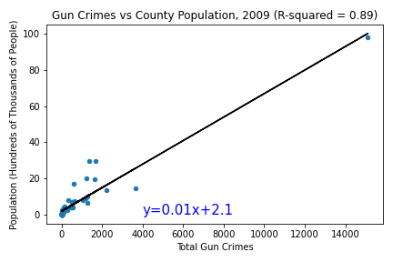
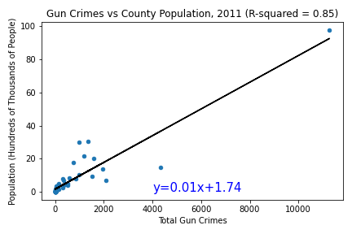
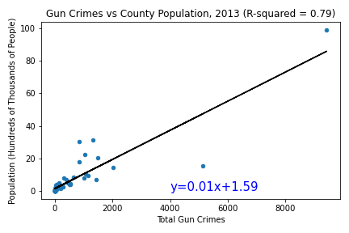
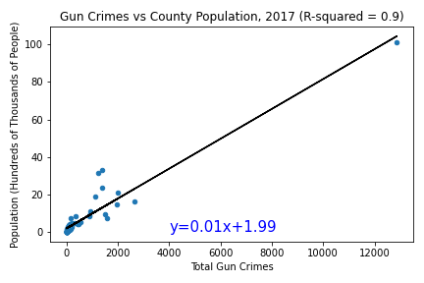
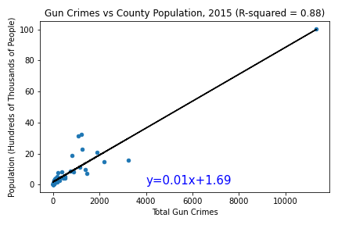
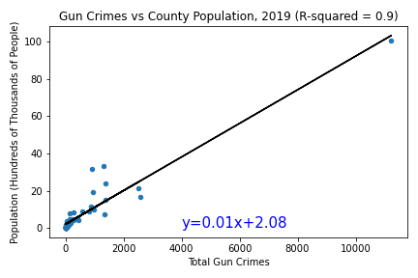
Gun Crime and Population

Slide 18
Summary of Conclusions / Discussion
There is no evidence Casinos attract crime
Number of gun stores has no impact on gun crime
Population size has some correlation with gun crime, but no clear causation
There is a relationship between the following:
Number of Liquor Licenses and Number of Calls
Number of Liquor Licenses and Number of Weapons
Number of Liquor Licenses and Population
Population and Number of Calls

Slide 19
Post Mortem
Difficulties / Challenges:
Limited data
Overambitious (is that a bad thing though?)
If we had 2 more weeks:
Increase the scope of data
Include additional cities, counties, states, etc.
Expand Scope of Analysis

Slide 20

Questions?

Slide 21
Appendix - Analysis Process Correlation between number of liquor stores to the number of reported crimes
Liquor stores data source: CA Dept of Alcoholic Beverage Control
https://www.abc.ca.gov/licensing/licensing-reports/licenses-by-county/
Selected only ‘Active Off-Sale Retail Licenses (i.e. liquor stores, grocery stores, packaged stores, etc.)
Off-sale means alcohol is consumed off-premises.
Narrowed data selection to 10 counties out of 58 counties in CA
Reported number of crimes data source: OpenJustice website
Source for crime statistics, firearms, gun violence, etc.
https://openjustice.doj.ca.gov/data

